Slide 1
ABC Call Volume Trend Analysis
BY Sakshi Rahiwal
Excel sheet link
https://1drv.ms/x/c/e1641d3ba3ec422b/EbhNXZOQQM1EsmzwNR7xWNEBoG72J6PtIArVV2mDW3rwTQ?e=HQnlQP
https://1drv.ms/x/c/e1641d3ba3ec422b/EeF223dbV99ChAn9nEhvDe8BQ474ZiTYjOuXC8DmibSpQA?e=VcNRiN

Slide 2
Project Description
Overview:
The project focuses on analyzing the inbound calls received by ABC, an insurance company, over a 23-day period. The dataset includes information about call duration, time of the call, agent details, and call status. The objective is to derive insights from the data to enhance customer experience and optimize manpower allocation.
Objectives:
Determine the average duration of incoming calls for each time bucket.
Visualize the total number of calls received over time.
Propose a manpower allocation plan to reduce the abandon rate from 30% to 10% during office hours.
Propose a manpower plan for handling night calls while maintaining a maximum abandon rate of 10%.

Slide 3
Approach
Data Analysis:
1. Average Call Duration:
Grouped data by time buckets.
Calculated the average call duration for each time bucket.
2. Call Volume Analysis:
Created a graph displaying the number of calls against time buckets.
3. Manpower Planning:
Analyzed the current abandon rate (30%) during office hours.
Calculated the minimum number of agents needed in each time bucket to achieve a 10% abandon rate.
4. Night Shift Manpower Planning:
Assumed 30 additional calls during the night.
Proposed a plan for handling night calls with a maximum abandon rate of 10%.

Slide 4
Tech-Stack Used
Software:
Microsoft Excel 2022
Purpose:
Excel was chosen for its versatility in handling and analyzing tabular data, making it suitable for the tasks in this project.

Slide 5
Insights Task 1 - Average Call Duration Analysis:
Objective:
The goal of this analysis is to determine the average duration of incoming calls for each time bucket, with a focus on identifying peak call duration times. Insights from this analysis can guide improvements in service efficiency during these high-demand periods.
Methodology:
1. Data Segmentation:
The dataset was segmented into time buckets to represent different periods of the day.
Time buckets were defined, e.g., 9-10 AM, 10-11 AM, etc.
2. Calculation of Average Call Duration:
For each time bucket, the average call duration was calculated.
Peak call duration times were identified based on higher-than-average durations.

Slide 6
Key Findings:
Identification of Peak Call Duration Times:
Analysis revealed specific time buckets with consistently higher average call durations.
At 10-11AM duration indicate complex issues being addressed during these periods.
2. Insights into Potential Areas for Improvement:
At 10-11AM duration times suggest potential areas for improvement in service efficiency.
Consideration of additional support or resources during these periods could enhance customer satisfaction.
Recommendations:
1. Peak Hour Resource Allocation:
Consider allocating additional resources or specialized agents during 10-11AM duration times to address complex issues efficiently.
2. Training and Process Optimization:
Provide additional training to agents for handling issues that contribute to extended call durations.
Optimize processes to streamline service delivery during 10-11AM .

Slide 7
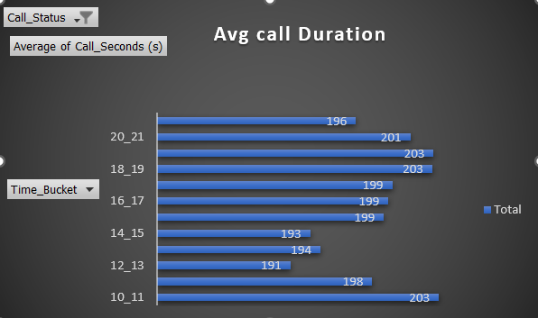
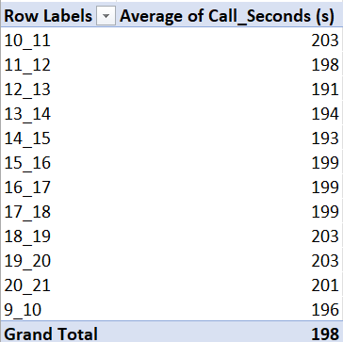
Conclusion Understanding and addressing 10-11am duration time is essential for optimizing service efficiency. By focusing on these periods, the customer experience can be enhanced, leading to increased satisfaction and loyalty. The insights gained from this analysis contribute to strategic decision-making for resource allocation and process improvement. :

Slide 8
Task 2 - Call Volume Analysis:
Objective:
The aim of this analysis is to visualize the total number of calls received over time, represented in time buckets. This visualization provides insights into the fluctuating call volumes throughout the day, highlighting potential high-demand periods.
Methodology:
1. Data Preparation:
The dataset was organized into time buckets, representing different periods of the day (e.g., 9-10 AM, 10-11 AM).
The total number of calls within each time bucket was calculated.
2. Graphical Representation:
A graph or chart was created to visually represent the number of calls against time buckets.
Time buckets were plotted on the x-axis, and the corresponding number of calls on the y-axis.

Slide 9
Key Findings:
Fluctuating Call Volumes:
The graph displays varying call volumes throughout the day.
At 11-12am and 8-9pm periods of high and low call activity.
2. Identification of High-Demand Periods:
At 11-12am(14626) highlight potential high-demand periods.
Understanding these periods is crucial for effective resource planning.
Recommendations:
1. Resource Allocation:
Allocate more staff during identified high-demand periods to ensure prompt customer service.
2. Strategic Scheduling:
Schedule breaks and meetings for staff during periods of lower call volume to maximize efficiency.

Slide 10
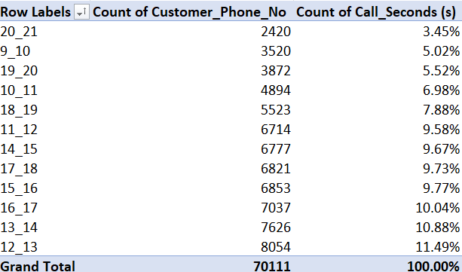
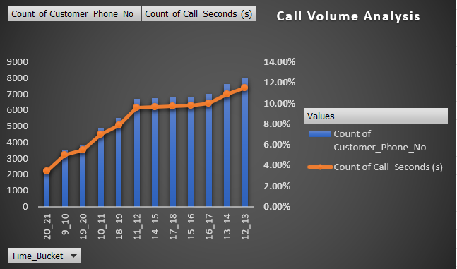
Predictive Analytics:
Consider implementing predictive analytics to forecast call volumes, enabling proactive resource planning.
Conclusion:
The visual representation of call volumes against time buckets provides valuable insights into the dynamics of customer interaction throughout the day. Identifying high-demand periods allows for strategic resource allocation and scheduling, optimizing the efficiency of the customer experience team. Further integration of predictive analytics can enhance proactive planning for future demand patterns.

Slide 11
Task 3 - Manpower Planning Analysis:
Objective:
The objective of this analysis is to propose a manpower allocation plan for each time bucket to reduce the abandon rate from 30% to 10%. This involves calculating the minimum number of agents required during each time period to ensure that at least 90 out of 100 calls are answered.
Methodology:
1. Current Abandon Rate Analysis:
Analyzed the current abandon rate, which is approximately 30%.
2. Calculation of Minimum Agents Required:
Calculated the minimum number of agents needed in each time bucket to achieve a 10% abandon rate.
Utilized the formula: Minimum Agents = (Total Calls / (1 - Target Abandon Rate)) - Total Calls.

Slide 12
Key Findings:
Current Abandon Rate:
The analysis confirmed the existing abandon rate of 30%, indicating a significant portion of calls going unanswered.
2. Minimum Agents Required:
Determined the minimum number of agents needed during each time bucket to achieve the target 10% abandon rate.
Recommendations:
1. Time-Specific Agent Allocation:
Allocate agents based on the calculated minimums for each time bucket.
Ensure a dynamic workforce that aligns with fluctuating call volumes.
2. Performance Monitoring:
Implement real-time performance monitoring to adjust agent allocation dynamically based on actual call volumes.

Slide 13
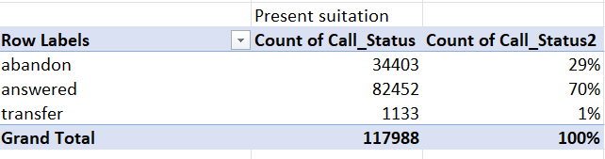
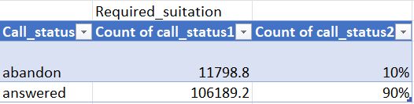
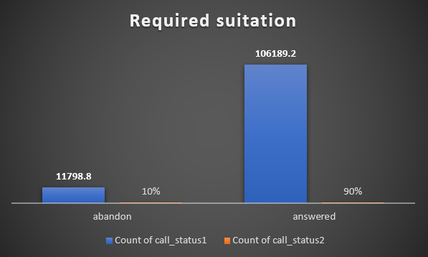
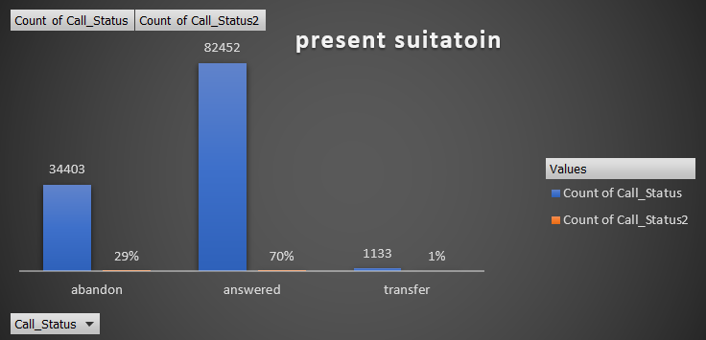
Conclusion:
The proposed manpower allocation plan aims to reduce the abandon rate to 10% by strategically assigning agents during different time buckets. This targeted approach ensures efficient handling of calls, improving customer satisfaction by minimizing the likelihood of calls going unanswered. Continuous monitoring and adjustment of workforce allocation based on actual call volumes are essential for sustained effectiveness.

Slide 14
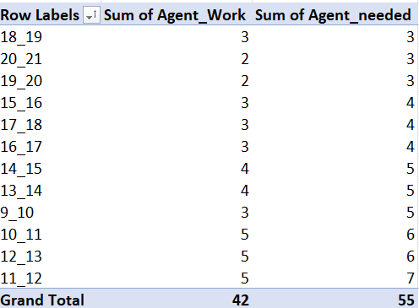
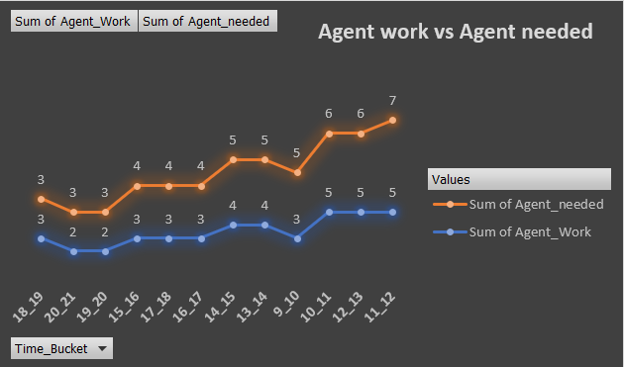
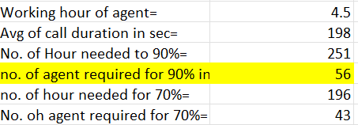
Agents Working VS Agents Needed

Slide 15
Task 4 - Night Shift Manpower Planning:
Objective:
The objective of this analysis is to propose a manpower plan for handling night calls, ensuring a positive customer experience while maintaining a maximum abandon rate of 10%. The assumption is that 30 calls are received at night (9 pm to 9 am) for every 100 calls received during the day.
Methodology:
1. Assumptions:
Night shift calls assumed to be 30% of the daily calls.
Maximum allowable abandon rate set at 10%.
2. Calculation of Minimum Agents Required for Night Shift:
Calculated the minimum number of agents needed during each night time bucket to achieve the target 10% abandon rate.

Slide 16
Key Findings:
Night Shift Call Distribution:
Assumed 30% of the daily calls occur at night (9 pm to 9 am), resulting in 30 additional calls.
2. Minimum Agents Required for Night Shift:
Determined the minimum number of agents needed during each night time bucket to ensure a 10% abandon rate.
Recommendations:
1. Night Shift Agent Allocation:
Allocate agents specifically for night shifts based on the calculated minimums.
Ensure well-trained agents capable of handling diverse issues.
2. Efficient Handover Processes:
Establish efficient handover processes between day and night shifts to ensure a seamless customer experience.
3. Performance Metrics Monitoring:
Monitor performance metrics during night shifts and adjust agent allocation as needed.

Slide 17
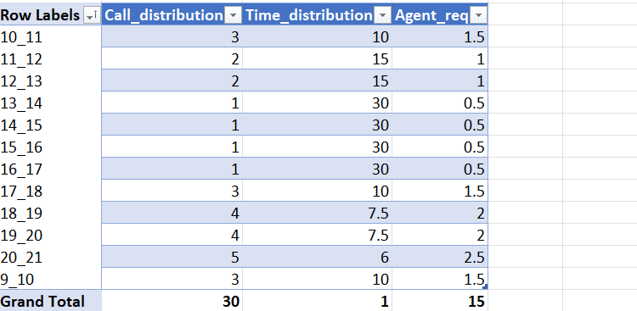
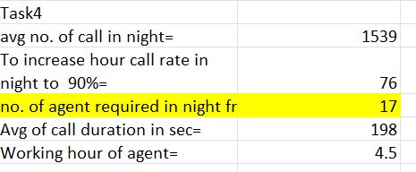
Conclusion:
The proposed manpower plan for night shifts is designed to handle the additional 30 calls efficiently while maintaining a maximum abandon rate of 10%. Allocating trained agents to the night shift ensures customers receive satisfactory service even during non-traditional hours. Continuous monitoring and adjustment based on performance metrics are essential for the success of the night shift manpower plan. This approach contributes to overall customer satisfaction by addressing the need for support during extended hours.

Slide 18
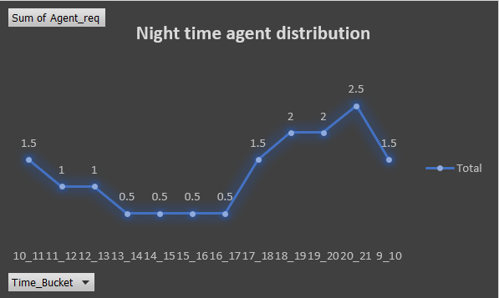
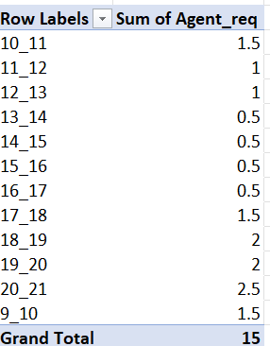
Agent Distribution in night

Slide 19
Results
Task 1 - Insights derived from average call duration during peak hours provide a strategic opportunity to enhance service efficiency. By addressing the specific challenges that contribute to longer call durations, the organization can streamline processes, optimize training, and improve overall customer satisfaction during high-demand periods. Continuous monitoring and adaptation to evolving patterns will be essential for sustained success in service optimization.
Task 2 - The graphical representation of call volume trends provides a clear visual understanding of daily patterns. Peaks and valleys in the graph indicate when the call volume is at its highest and lowest, guiding strategic decisions for resource allocation and scheduling. The insights gained from this analysis contribute to optimizing the efficiency of the customer experience team, ensuring a seamless experience for customers throughout the day. Continuous monitoring and adjustment of staffing levels based on call volume trends are essential for sustained effectiveness.
Task 3 - The proposed Manpower Planning aims to address the challenge of high abandon rates during office hours by strategically allocating agents. By ensuring the availability of a sufficient number of agents in each time bucket, the plan targets a 10% abandon rate, enhancing customer satisfaction. Real-time monitoring and adjustments, along with cross-training initiatives, contribute to the adaptability and efficiency of the workforce. Continuous improvement and optimization of the agent allocation plan will be essential for sustaining the target abandon rate and improving overall service quality.

Slide 20
Result
Task 4 - The proposed Night Shift Manpower Planning aims to provide efficient and customer-centric support during non-traditional hours. By allocating trained agents, implementing efficient handover processes, and monitoring performance metrics, the plan seeks to enhance overall customer satisfaction. Continuous training and improvement initiatives ensure that the night shift team remains well-prepared to handle diverse customer needs.

Slide 21
THANK YOU

